Slide 1
Incident Response – Test Cases(Priority 3 response_SM_TCS)
SLA Clause Details | Incident Response – P3 Incidents
Definition | The percentage of Priority 3 Incidents which are responded within 2 hour in 8-5 weekdays excluding holidays window.
SLA name | Priority 3 response_SM_TCS
Retroactive start and Retroactive Pause | True
Start | Incident Active = True, Priority is 3, Support Group Type = TCS Groups(clock start at the time ticket was submitted because of set start to “Created”)
Pause | NA
Completed | 'Assigned To' != NULL
SLA time zone | The Caller Time Zone
Unit of measurement | Hours/Minutes

Slide 2
Use SLA retroactive start and pause
You can use retroactive start to retain timing information for an SLA when a task record changes. Retroactive pause prevents immediate breaches and notifications when retroactive start is enabled for SLA definitions.
About this task
When a task record changes, typically a new SLA may be attached, with a new set of timing information. This is useful if you are re-assigning an incident to another group and want to attach a new SLA record with new timing information.
However, you may want to retain time information for the task in specific situations. For example, an incident is raised with a priority of 3 - Moderate and the priority changes to 1 - Critical after 3 hours. A priority 1 SLA is attached to the incident at that time. You can use retroactive start to ensure this SLA timing is adjusted retroactively to count from when the incident was first created, rather than from when the incident's priority changed.
You can use the retroactive pause property to apply pause times to the new SLA.

Slide 3
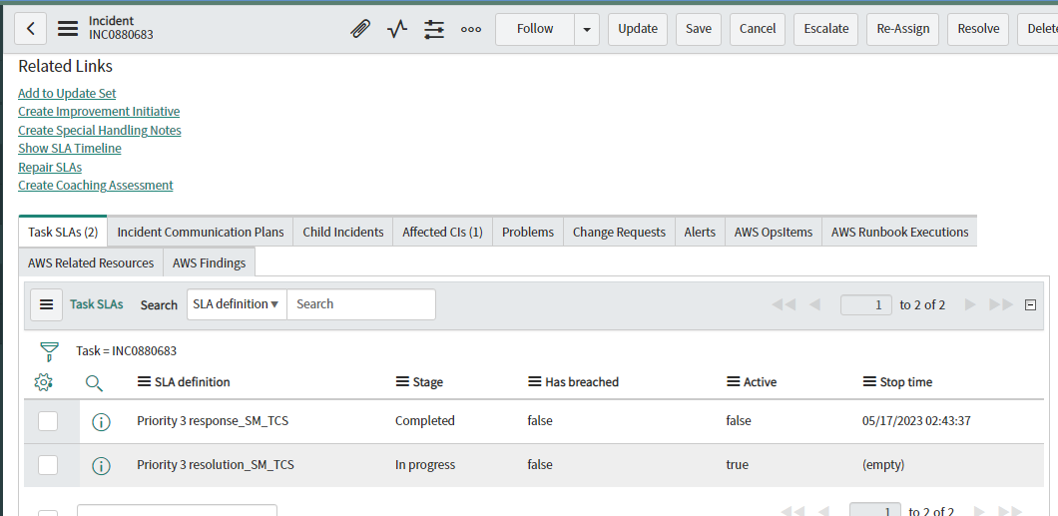
1. Test Case:- Incident Created in ServiceNow.
Once the Incident got created in ServiceNow there will be one Response and one Resolution SLA will get attached to the incident, and the start time will be calculated from the time being the incident got created in the system because of retro active is set to start.
Response SLA will stop once the ticket is assigned to an Engineer.

Slide 4
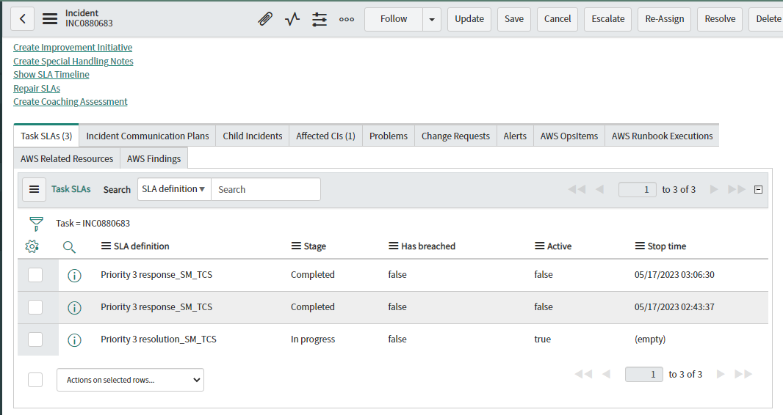
2. Test Case:- Incident Reassigned to another support group within TCS.
As per the SLA condition, once the incident got reassigned to another support group within TCS, one more Response SLA will get attached to the Incident, and the start time will be calculated from the time being the incident got created in the system because of retro active is set to start.
Response SLA will stop once the ticket is assigned to an Engineer.

Slide 5
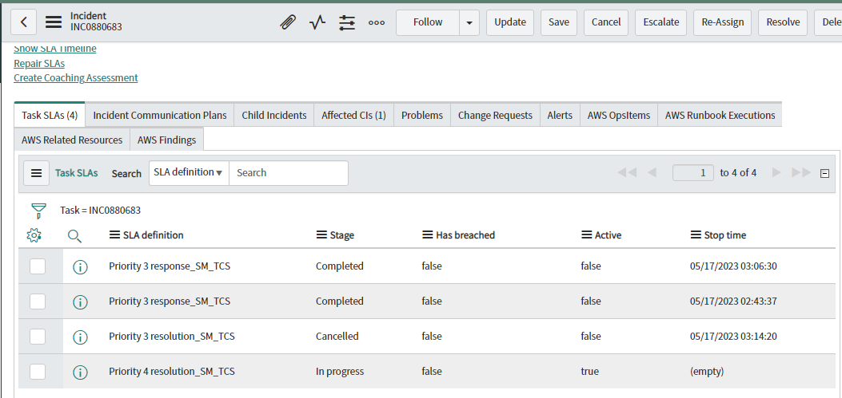
3. Test Case:- Incident Downgraded from P3 to P4.
As per the SLA condition, once the incident got downgraded, P3 Resolution SLA will get cancelled and P4 Resolution SLA will get attached to the Incident, and the start time will be calculated from the time being the incident got created in the system because of retro active set to start. For downgraded incident, Response SLA will not be attached due to the SLA condition.
Note:- After downgrade if the incident got reassigned again Response SLA will get attached.

Slide 6
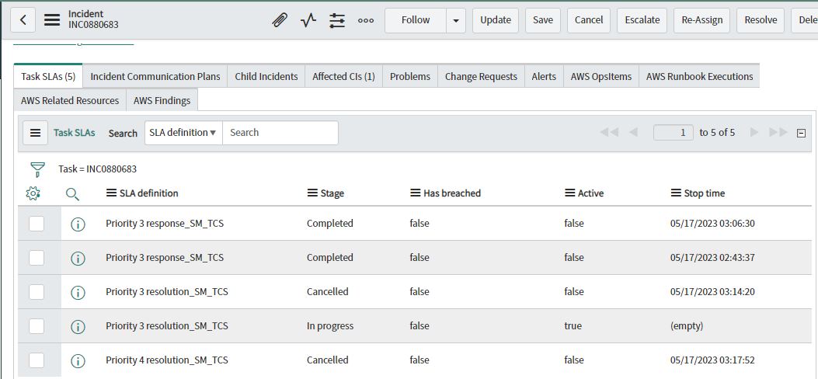
4. Test Case:- Incident Upgraded from P4 to P3.
As per the SLA condition, once the incident got upgraded, P4 Resolution SLA will get cancelled and P3 Resolution SLA will get attached to the Incident, and the start time will be calculated from the time being the incident got created in the system because of retro active is set to start. For upgraded incident, Response SLA will not be attached due to the SLA condition.
Note:- After upgraded if the incident got reassigned again Response SLA will get attached.

Slide 7
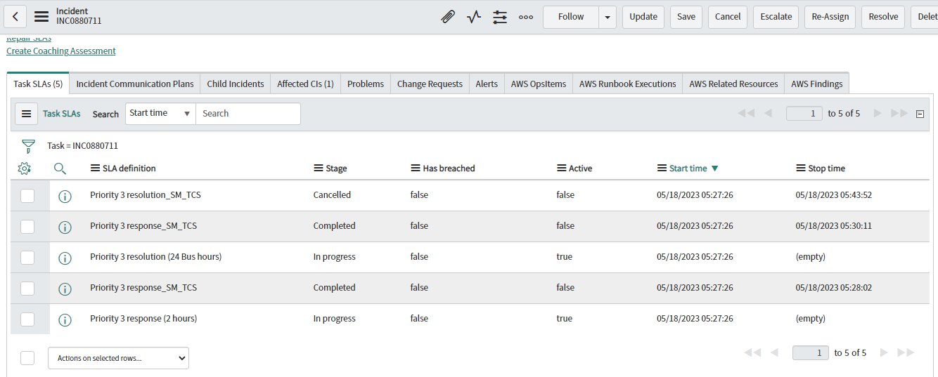
5. Test Case:- Incident Reassigned to Non TCS Groups.
As per the SLA condition, once the incident got reassigned to NON-TCS, TCS SLA’s will get cancelled and Global SLA’s will get attached to the Incident.
Response SLA will stop once the ticket is assigned to an Engineer.

Slide 8
Incident Response – Test Cases(Priority 3 SLA_TCS_Test Single response)
SLA Clause Details | Incident Response – P3 Incidents
Definition | The percentage of Priority 3 Incidents which are responded within 2 hour in 8-5 weekdays excluding holidays window.
SLA name | Priority 3 SLA_TCS_Test Single response
Retroactive start and Retroactive Pause | True
Start | Incident Active = True, Priority is 3, Support Group Type = TCS Groups, Reassignment Count = 0 (clock start at the time ticket was submitted because of set start to “Created”)
Pause | NA
Completed | 'Assigned To' != NULL
SLA time zone | The Caller Time Zone
Unit of measurement | Hours/Minutes

Slide 9
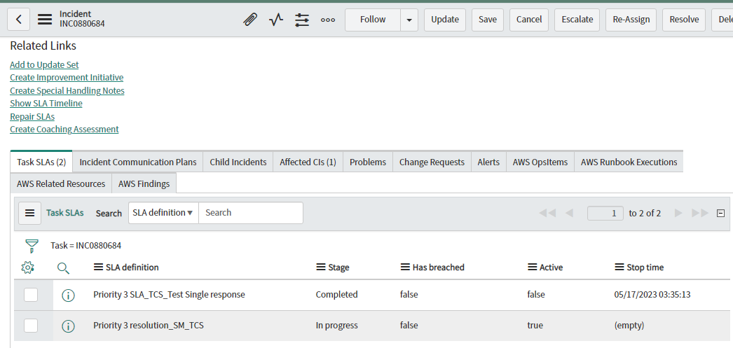
1. Test Case:- Incident Created in ServiceNow.
Once the Incident got created in ServiceNow there will be one Response and one Resolution SLA will get attached to the incident, and the start time will be calculated from the time being the incident got created in the system because of retro active set to start.
Response SLA will stop once the ticket is assigned to an Engineer.

Slide 10
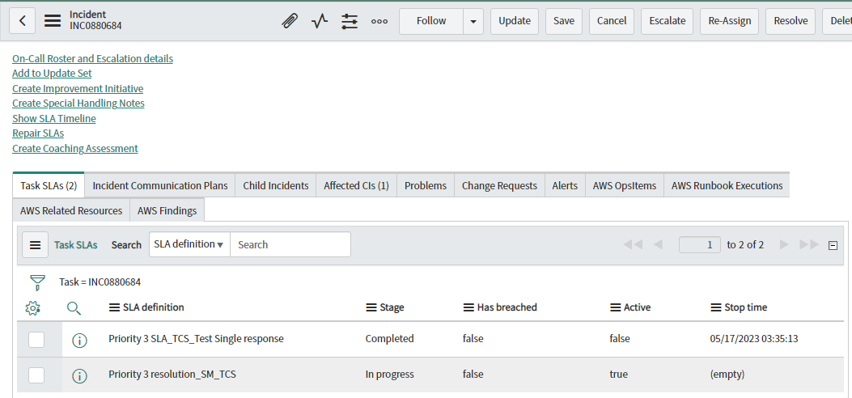
2. Test Case:- Incident Reassigned to another support group within TCS.
As per the SLA condition, once the incident got reassigned to another support group within TCS, there will not be any new Response SLA attached to the incident.
Note:- SLA Start condition is set to “Reassignment count = 0”, because of which we could see only first Response to the incident.

Slide 11
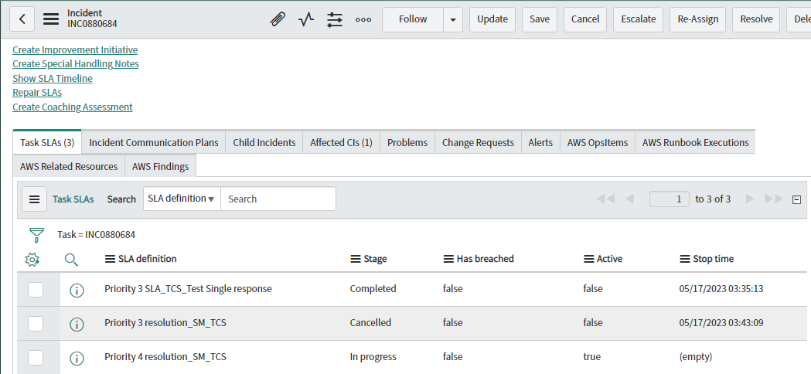
3. Test Case:- Incident Downgraded from P3 to P4.
As per the SLA condition, once the incident got downgraded, P3 Resolution SLA will get cancelled and P4 Resolution SLA will get attached to the Incident, and the start time will be calculated from the time being the incident got created in the system because of retro active is set to start.
Note:- For downgraded incident, Response SLA will not be attached due to the SLA condition.

Slide 12
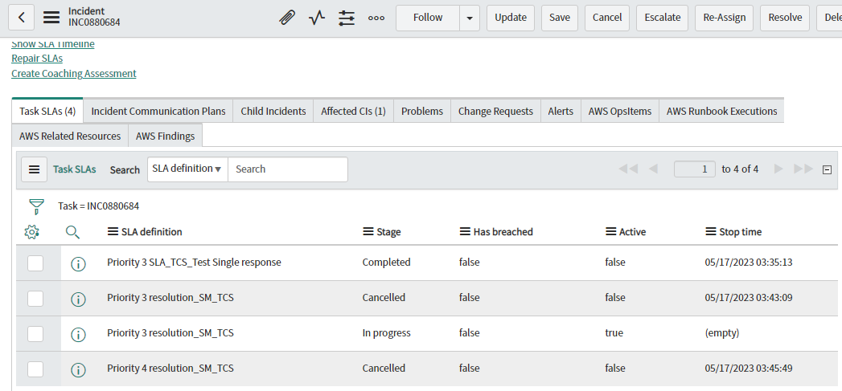
4. Test Case:- Incident Upgraded from P4 to P3.
As per the SLA condition, once the incident got upgraded, P4 Resolution SLA will get cancelled and P3 Resolution SLA will get attached to the Incident, and the start time will be calculated from the time being the incident got created in the system because of retro active is set to start.
Note:- For upgraded incident, Response SLA will not be attached due to the SLA condition.

Slide 13
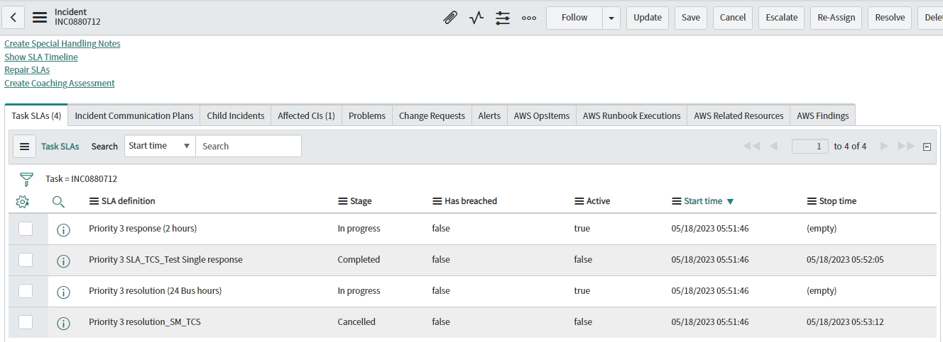
5. Test Case:- Incident Reassigned to Non TCS Groups.
As per the SLA condition, once the incident got reassigned to NON-TCS, TCS SLA’s will get cancelled and Global SLA’s will get attached to the Incident.
Response SLA will stop once the ticket is assigned to an Engineer.

Slide 14
Incident Response – Test Cases(Priority 3 response_SM_TCS_Test2 Multi)
SLA Clause Details | Incident Response – P3 Incidents
Definition | The percentage of Priority 3 Incidents which are responded within 2 hour in 8-5 weekdays excluding holidays window.
SLA name | Priority 3 response_SM_TCS_Test2 Multi
Retroactive start and Retroactive Pause | True
Start | Incident Active = True, Priority is 3, Support Group Type = TCS Groups (clock start at every reassignment due to retro active is not set)
Pause | NA
Completed | 'Assigned To' != NULL
SLA time zone | The Caller Time Zone
Unit of measurement | Hours/Minutes

Slide 15
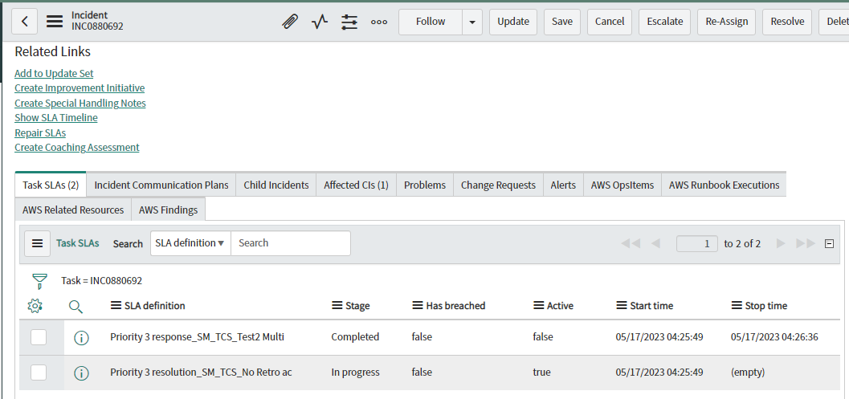
1. Test Case:- Incident Created in ServiceNow.
Once the Incident got created in ServiceNow there will be one Response and one Resolution SLA will get attached to the incident.
Response SLA will stop once the ticket is assigned to an Engineer.

Slide 16
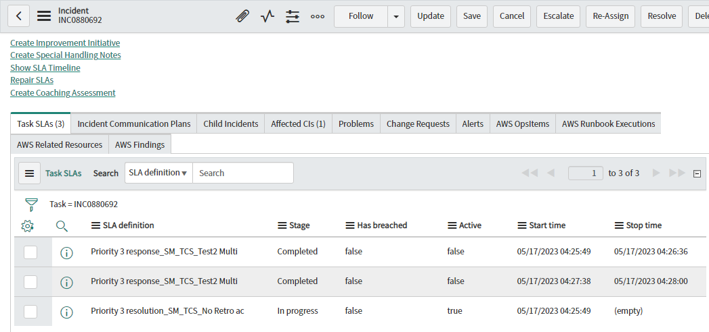
2. Test Case:- Incident Reassigned to another support group within TCS.
As per the SLA condition, once the incident got reassigned to another support group within TCS, one more Response SLA will get attached to the Incident, and the time will be calculated from the time being the incident got reassigned in the system because of retro active is not set in the condition.
Response SLA will stop once the ticket is assigned to an Engineer.

Slide 17
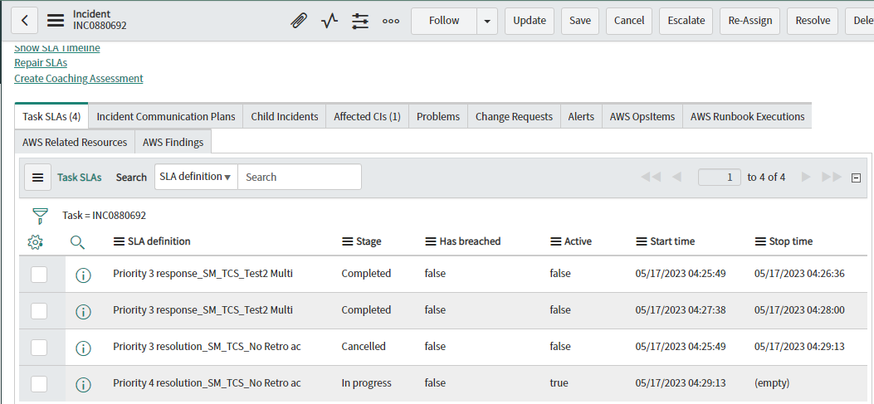
3. Test Case:- Incident Downgraded from P3 to P4.
As per the SLA condition, once the incident got downgraded, P3 Resolution SLA will get cancelled and P4 Resolution SLA will get attached to the Incident, and the time will be calculated from the time being the incident got reassigned in the system because of retro active is not set in the condition. For downgraded incident, Response SLA will not be attached due to the SLA condition.
Note:- After downgrade if the incident got reassigned again Response SLA will get attached.

Slide 18
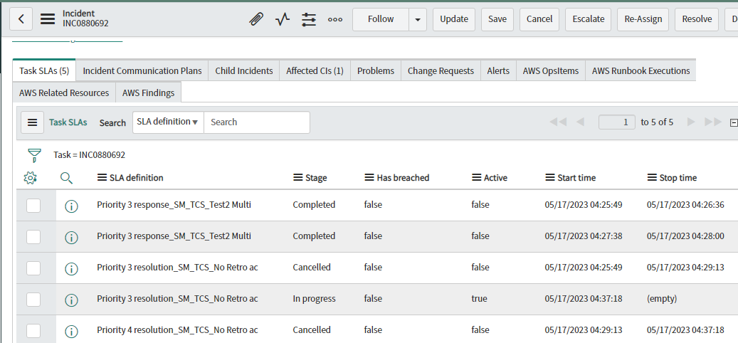
4. Test Case:- Incident Upgraded from P4 to P3.
As per the SLA condition, once the incident got upgraded, P4 Resolution SLA will get cancelled and P3 Resolution SLA will get attached to the Incident, and the time will be calculated from the time being the incident got reassigned in the system because of retro active is not set in the condition. For upgraded incident, Response SLA will not be attached due to the SLA condition.
Note:- After upgrade if the incident got reassigned again Response SLA will get attached.

Slide 19
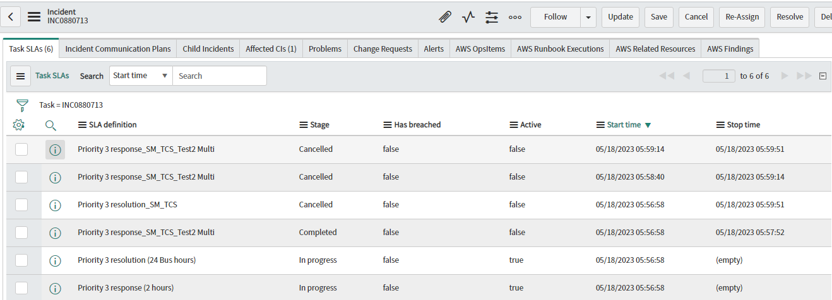
5. Test Case:- Incident Reassigned to Non TCS Groups.
As per the SLA condition, once the incident got reassigned to NON-TCS, TCS SLA’s will get cancelled and Global SLA’s will get attached to the Incident.
Response SLA will stop once the ticket is assigned to an Engineer.

